Slide 1


Accessible
Prototyping Software
Phase 1 Presentation
Tristin Bates, Melody Shih,
Troy Franks and Munene Mwenda

Slide 2




TODAYS
Agenda
The Problem
Gap Analysis
Research Questions
Objectives

Slide 3

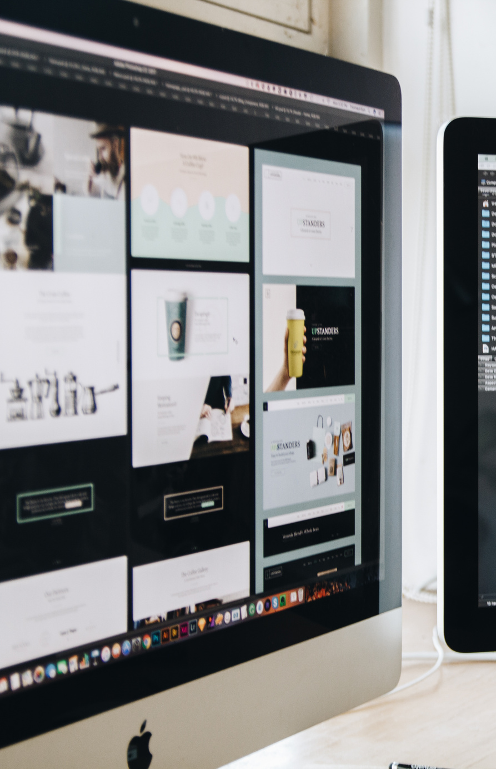

SHORT BRIEF
The
Problem
Current UI prototyping software, such as Figma, often leave many groups of people behind.
Problems
Prototyping tools are visually complex.
Limited support for screen readers and assistive tech.
Steep learning curves for beginners.
Why do these problems matter?
Prototyping is critical for the SDLC
Excludes visually impaired developers and beginners
Reduces collaboration and early feedback.

Slide 4




Gap
Analysis
What Current Research
Focuses On:
What's Missing?:
Identified Research
Gap:
Emphasizes efficiency, productivity, and visual fidelity
Rapid and data-driven prototyping improves speed and usability
Especially beneficial for novice designers
Prototypes treated mainly as visual artifacts
Little consideration of how assistive technologies interact during design
Accessibility addressed late, usually during testing
Limited research on semantic, non-visual prototypes
Minimal support for assistive technology users in co-design
Need for accessibility embedded directly into the prototyping process

Slide 5


Questions
Research
How can semantic, intent-driven prototyping allow assistive technologies to interact with and modify prototypes?
How can shared semantic representations support equitable co-design among all team members?

Slide 6
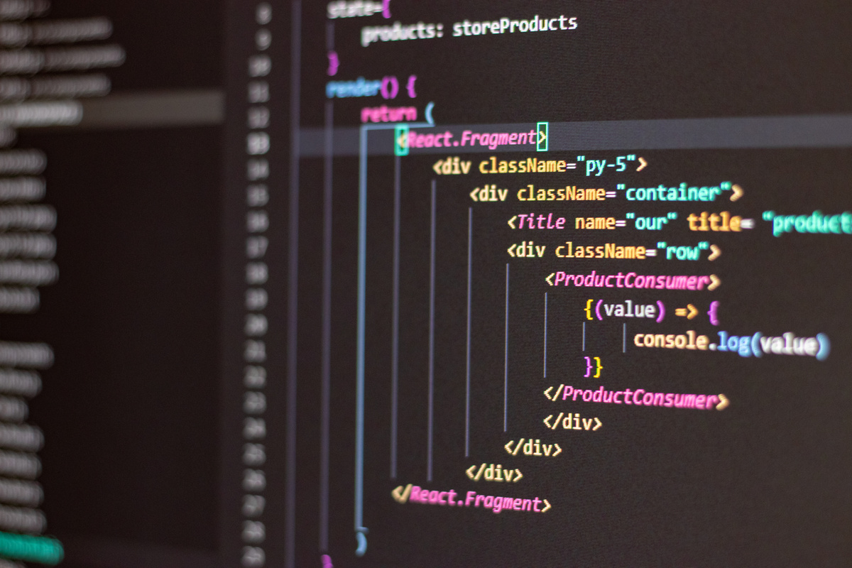
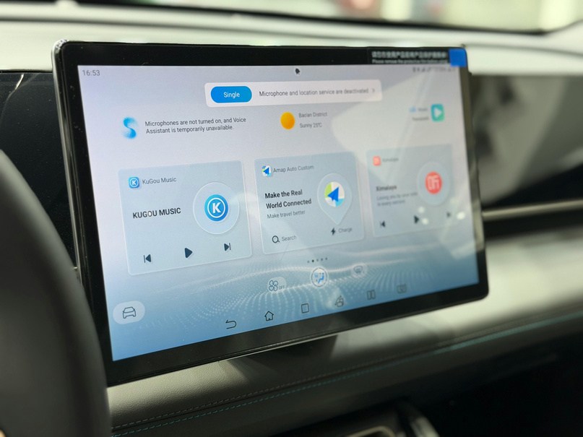

Solution
Objectives
Accessibility & Collaboration
Usability & Real-Time Consistency
Semantic, intent-based prototype representation
Screen reader–friendly structure (not visual-only)
Real-time annotations via text, audio, and semantic edits
Ensures assistive technology users can fully participate in design
Progressive, keyboard-navigable interface
Reduced learning curve for new users
Real-time semantic visual synchronization
One shared prototype state for all collaborators

Slide 7
Implementation
How Are We Going To Implement This?
What languages will we be using?
We are currently looking into creating an extension for Figma that enables screen reader support, and then from there move onto converting our extension into its own stand-alone software.
Figma extensions use JavaScript and HTML for development, so our future prototyping software will be web based. We are hoping to a working prototype by week 8.

Slide 8

The
End

